Slide 1
What the Body Reveals about Lay Knowledge of Psychological Flexibility
Presented by Neal Falletta-Cowden, MA, BCBA, LBA
University of Nevada, Reno

Slide 2
Psychological Flexibility
Psychological flexibility refers to a set of behavioral processes relevant to psychological health
These processes are targeted by intervention methods grouped under the label of “third wave” cognitive behavioral therapy (e.g. ACT)¹
Psychological flexibility processes are among the most common mediators of psychological interventions²
Psychological flexibility consists of becoming³:
Emotionally and cognitively open
Consciously aware of the present moment
Actively engaged in values-based living

Slide 3
Psychological Flexibility in Common Experience
The culture at large seems surprised at the idea that remaining open to potentially aversive experiences can result in positive outcomes
In principle, life experience should be a skillful teacher of flexibility processes as inflexibility is rarely rewarded
For example, facing the challenging moments in our lives head-on rather than avoiding them should be rewarded in the long-term
We should be “wiser from experience”
One possibility is that we DO learn these lessons, but not verbally

Slide 4
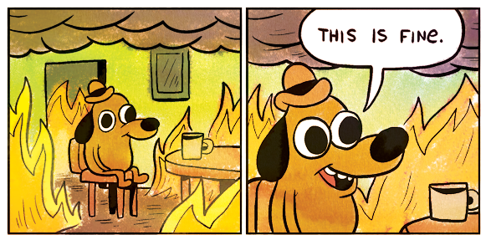
Language and the Culture
Plenty of skills learned through experience are difficult to explain using spoken language, such as balancing on a bike
For example, people can respond physically to contingencies they are completely unable to verbalize⁴
In addition, the culture may actively encourage inflexibility with phrases like “stop thinking about it” or ”its not worth worrying about”
With all these factors in mind, it may be possible that people can learn flexibility processes through non-verbal means

Slide 5
The Present Study
We examined the possibility of widespread ”embodied” knowledge of psychological flexibility
By “embodied” we mean the definitional sense: “To give a bodily form to: incarnate.”⁵
We asked two questions about this embodied knowledge:
Can untrained individuals reliably use psychological flexibility terms to evaluate the meaningful bodily positioning of others
Will people metaphorically display psychological flexibility or inflexibility with their body when expressing best and worst mental postures toward the same psychologically challenging event

Slide 6
Methods – Photo participants
Participants: 98 total individuals, 82 photo participants and 16 photo raters
31 adults from Reno, NV, 32 from Chicago, IL, and 19 recent immigrants from Iran living in the Washington DC and Maryland area
28 male photo participants, 53 female, and 3 did not disclose gender
Photo participants were asked to think of a major challenge they faced such as a difficult thought, painful feeling, or sensation
They were then asked to put their body in a posture showing how they would face this challenge at their “best” versus their “worst”

Slide 7
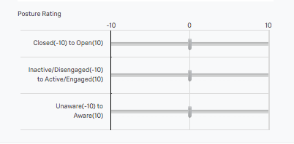
Methods – Photo raters
Photos were rated by 16 photo raters naïve to psychological flexibility processes or terminology
Each rater was shown a total of 164 photos
Photo raters were asked to rate photo subjects’ postures on their openness, awareness, and engagement on this scale

Slide 8
Data Analysis Approach
First assessed whether simple verbal labels for the “pillars” of the psychological flexibility model (open, aware, and engaged) would lead to reliable ratings of whole-body photographs
Reliability of these measures was examined by calculating intraclass correlation coefficients (ICCs) for each across all photos and raters
Chronbach’s alpha was used to assess whether measures covaried in ways that suggested a common core concept of “embodied psychological flexibility”
Paired associate t-tests were used to examine pose instructions as an independent variable within each participant
Finally, differences between three photo subject populations was tested using a repeated measures ANOVA with location as a between factor and pose instructions as the within factor across various measures

Slide 9
Results
Untrained raters could reliably use psychological flexibility terms to rate photos
ICC results showed excellent reliability based on common standards⁶:
0.963 for open (95% CI: 0.954–0.971)
0.959 for aware (95% CI: 0.948–0.968)
0.951 for engaged (95% CI: 0.938–0.961)
Cronbach’s alpha was .965, suggesting that the three measures could be treated as a composite of a common core concept
T-tests showed a significant difference between “best” and “worst” poses
(t(82)=12.64, p<0.0001, d=1.40; best mean and SE=3.65(.40);Worst mean and SE=-3.82(.42))

Slide 10
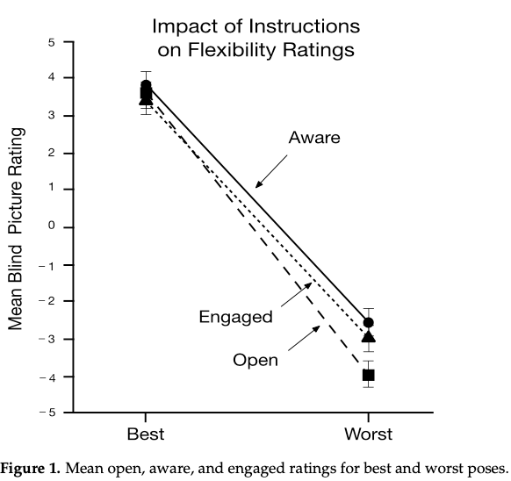
Individual Rating Analysis
Pictures of “best” pose compared to the “worst” pose were seen as more:
Open t(81)=14.00, p<.0001, d=1.55
Aware t(81)=10.80, p<.0001, d=.91
Engaged t(81)=11.01, p<.0001,d=.93

Slide 11
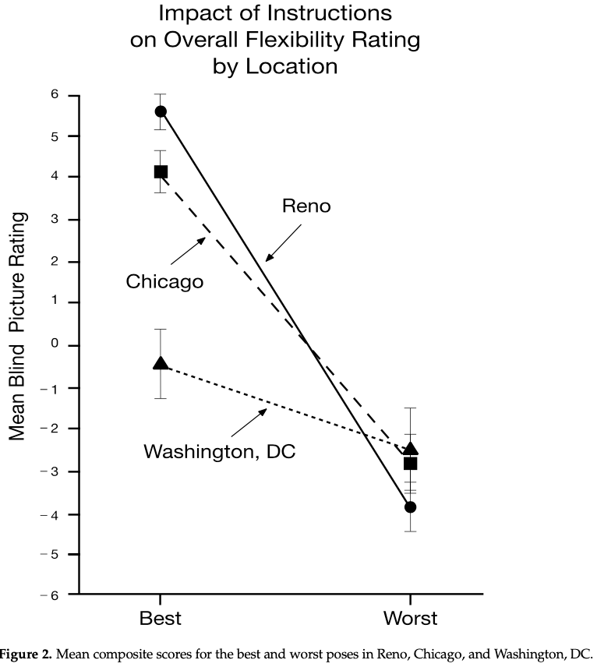
Cross-Sample Results
When location of photo subjects was used as a between variable, results showed:
a large significant effect for pose (F 1,79)=184.19,p<.0001, partial eta sq=.70)
a smaller significant effect for location ((F 2,79)=5.17, p=.008, partial eta sq = .12)
a medium significant effect for their interaction ((F 2,79)=20.73,p<.0001, partial eta sq=.34)
“Best” photos differed for immigrants to Washington D.C. compared to other samples

Slide 12
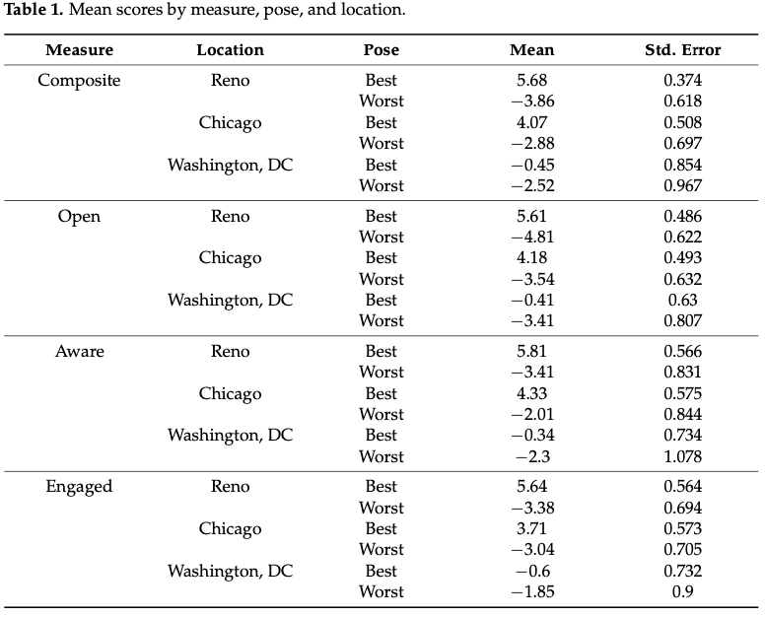
Results cont’d
75 of 82 photo participants (91.4%) showed lower composite scores in the worst pose versus the best pose
All seven who did not were male, and six were from Iran
Some Iranian males had their hands clasped as if in prayer during “best” photos, which may have led to the only nonsignificant effect

Slide 13
Psychological Flexibility Terms are Intuitive
Our results suggest that most members of the public already have embodied knowledge of psychological flexibility concepts
The open, aware, and engaged terms can be used reliably by naïve raters to evaluate the “body language” of others
People show more physical indications of openness, awareness, and engagement when asked to pose at their “best” versus worst when dealing with psychological issues

Slide 14
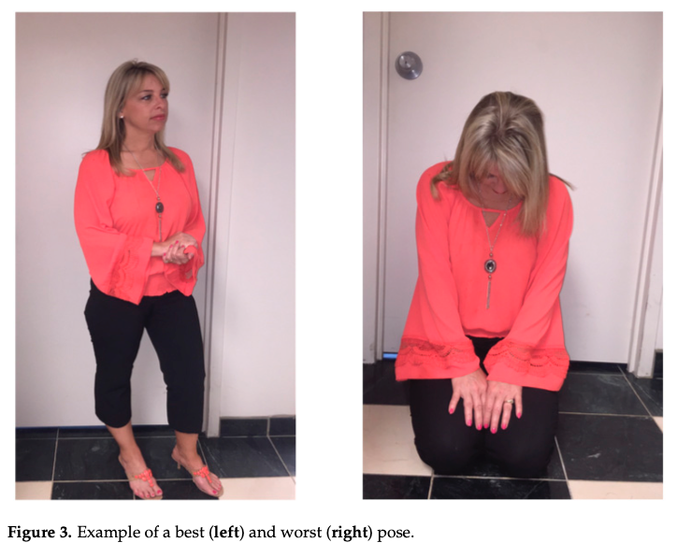
Poses
In “best” pose, eyes are looking forward, shoulders wide, and feet apart
In the “worst” pose, her head is lowered, shoulders slumped, and knees and elbows pulled inwards
She is more engaged with the world at her best, and more closed off at her worst

Slide 15
Location Differences
Traditional self-reports of psychological flexibility are robust across cultures⁷, however this may not apply to embodied knowledge
Iranian males showed a lack of differences between poses, signaling that gender-linked cultural differences need further investigation
Photo raters from the USA may have had a harder time understanding the body language of those from Iran
Cultural experience is known to impact the understanding of “bodily dialects” in intercultural non-vocal communication⁸

Slide 16
Utility of Understanding Body Language
Psychotherapists should attend to their clients’ postures as indications of their openness, awareness, and engagement
This information may be used for real-time assessments of clients’ psychological states
In process-based approaches to therapy, the therapist may ask clients to “show me with your body how you’re dealing with X issue today.”
If used carefully, this may augment therapeutic alliance and shared understanding
In exposure-based interventions, body positions may be used to increase awareness and choice in the face of aversive experiences

Slide 17
Future Directions
This is an exploratory study, and further research will need to control variables more tightly, such as taking all photos against the same backdrop and limiting cross-cultural influences
A power analysis could not be conducted to determine the best sample size, which is a limitation of the current study
We did not vary which pose was assumed first while taking photos, so the possibility of an order effect was not controlled
Despite these limitations, the study demonstrates that life experience alone may be a subtle teacher of psychological flexibility

Slide 18
References:
1. Hayes, S.C.; Villatte, M.; Levin, M.; Hildebrandt, M. Open, aware, and active: Contextual approaches as an emerging trend in the behavioral and cognitive therapies. Annu. Rev. Clin. Psychol. 2011, 7, 141–168.
2. Hayes, S.C.; Hofmann, S.G.; Ciarrochi, J.; Chin, F.T.; Baljinder, S. How change happens: What the world’s literature on the mediators of therapeutic change can teach us. In Evolution of Psychotherapy Conference; Erickson Foundation: Hudson, NH, USA, 2020.
3. Hayes, S.C.; Strosahl, K.D.; Wilson, K.G. Acceptance and Commitment Therapy: The Process and Practice of Mindful Change; Guilford Press: New York, NY, USA, 2012.
4. Hefferline, R.; Keenan, B.; Harford, R. Escape and avoidance conditioning in human subjects without their observation of the response. Science 1959, 130, 1338–1339.
5. American Heritage Dictionaries. American Heritage Dictionary of the English Language, 5th ed.; Houghton Mifflin Harcourt
Publishing: New York, NY, USA, 2018.
6. Koo, T.K.; Li, M.Y. A guideline of selecting and reporting intraclass correlation coefficients for reliability research. J. Chiropr. Med.
2016, 15, 155–163
7. Monestès, J.L.; Karekla, M.; Hayes, S.C. Experiential avoidance as a common psychological process in European cultures. Eur. J. Psychol. Assess. 2017, 34, 247–257
8. Molinsky, A.L.; Krabbenhoft, M.A.; Ambady, N.; Choi, Y.S. Cracking the nonverbal code: Intercultural competence and gesture recognition across cultures. J. Cross-Cult. Psychol. 2005, 36, 380–395.
Contact:
Neal.falletta.cowden@gmail.com for more information

